Slide 1
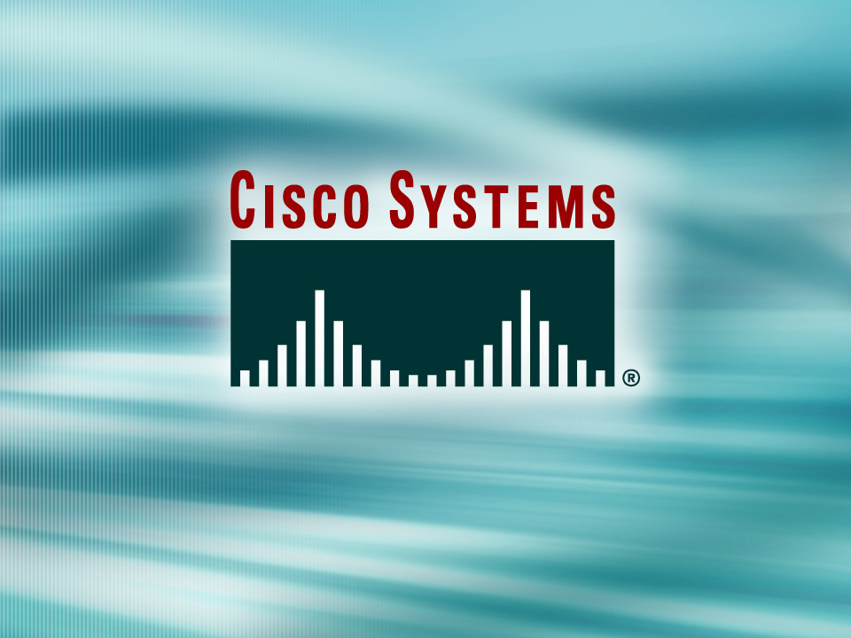
© 2002, Cisco Systems, Inc. All rights reserved.

Slide 2

Variable-Length
Subnet Masks
© 2002, Cisco Systems, Inc. All rights reserved.
Notes:
Purpose: This chapter introduces the Cisco IOS™ CLI on the Catalyst® 1900 switch and router.
Timing: This chapter should take about 2 hours to present.
Note: The Catalyst 1900 switch only has a subset of the router Cisco IOS commands available.
Contents:
Introduction to Cisco IOS. Explain to the student what is IOS?
Cisco Device startup procedures in general.
IOS configuration source.
General introduction to the IOS CLI.
Cat 1900 switch startup procedures.
Intro to Cat 1900 CLI. This part covers the basic configuration on the switch, like setting the IP address and hostname. More details about the various Cat 1900 switch configuration commands are explained in Chapter 6 and 7.
Router startup procedures. More details on the router startup process is discussed in chapter 5.
Router IOS CLI.

Slide 3
Objectives
Upon completing this lesson, you will be able to:
  Explain the operation of variable-length subnet masks on Cisco routers
Notes:
Slide 1 of 2
Purpose: This slide states the chapter objectives.
Emphasize: Read or state each objective so that each student has a clear understanding of the chapter objectives.
Note: Catalyst switches have different CLIs. The Catalyst 2900xl and the Catalyst 1900 has a Cisco IOS CLI. The Cisco IOS CLI commands available on the 2900xl is different from the 1900. The Catalyst 5000 family has no Cisco IOS CLI, and use the set commands instead. This class only covers the configuration on the Catalyst 1900 switch.

Slide 4
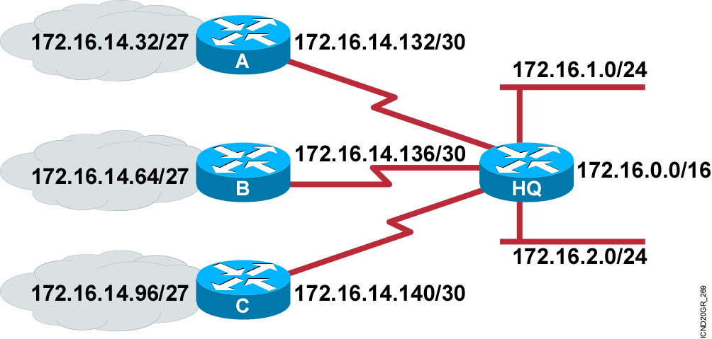
What Is a Variable-Length
Subnet Mask?
  Subnet 172.16.14.0/24 is divided into smaller subnets:
    Subnet with one mask (/27)
    Then further subnet one of the unused /27 subnets into multiple /30 subnets

Slide 5
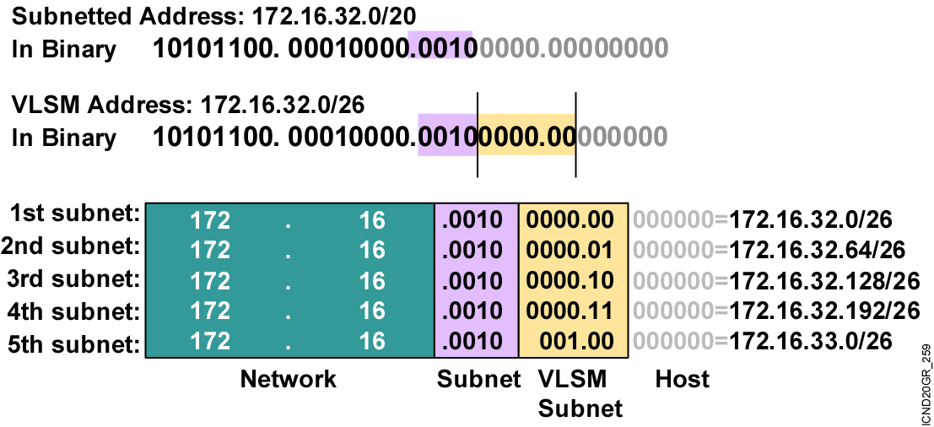
Calculating VLSMs

Slide 6
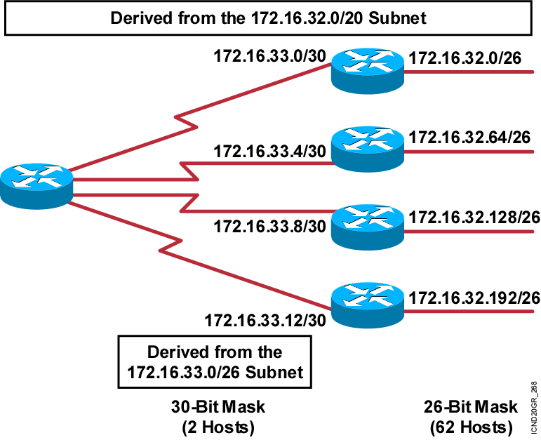
A Working VLSM Example

Slide 7
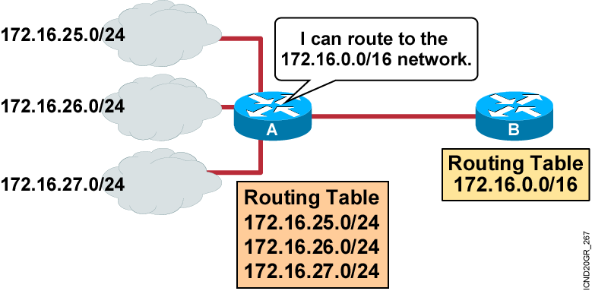
What Is Route
Summarization?
  Routing protocols can summarize addresses of several networks into one address

Slide 8
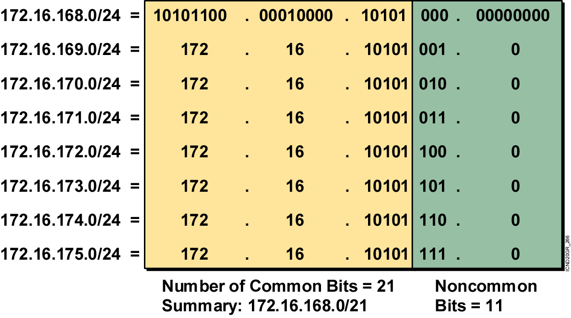
Summarizing Within an Octet

Slide 9
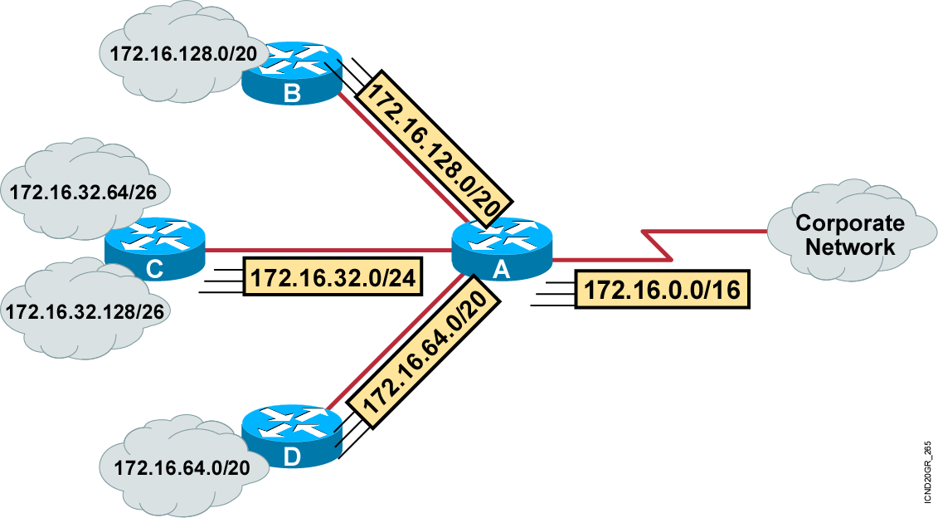
Summarizing Addresses in a VLSM-Designed Network

Slide 10
Implementation Considerations
  Multiple IP addresses must have the same highest-order bits.
  Routing decisions are made based on the entire address.
  Routing protocols must carry the prefix (subnet mask) length.

Slide 11
Route Summarization Operation in Cisco Routers
192.16.5.33 /32 Host
192.16.5.32 /27 Subnet
192.16.5.0 /24 Network
192.16.0.0 /16 Block of Networks
0.0.0.0 /0 Default
  Supports host-specific routes, blocks of networks, default routes
  Routers use the longest match

Slide 12
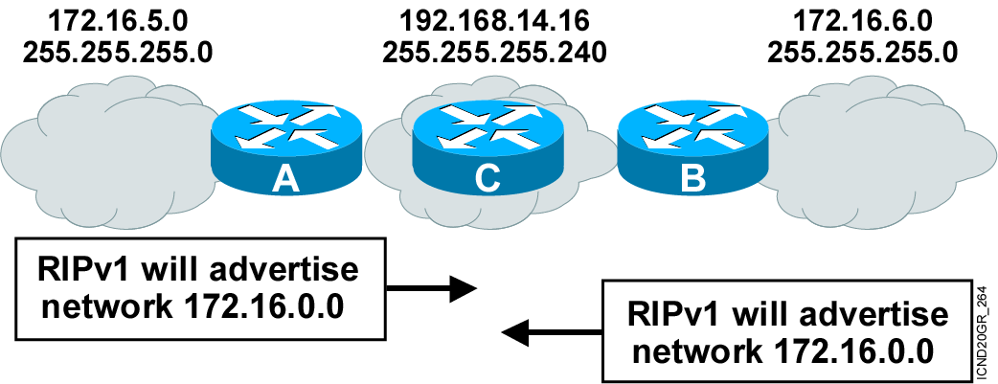
Summarizing Routes in a Discontiguous Network
  RIPv1 and IGRP do not advertise subnets, and therefore cannot support discontiguous subnets.
  OSPF, EIGRP, and RIPv2 can advertise subnets, and therefore can support discontiguous subnets.

Slide 13
Summary
  When an IP network is assigned more than one subnet mask, it is considered a network with variable-length subnet masks, overcoming the limitation of a fixed number of fixed-size subnetworks imposed by a single subnet mask.
  In large internetworks, hundreds or even thousands of network addresses can exist. In these environments, it is often not desirable for routers to maintain many routes in their routing table. Route summarization, also called route aggregation or supernetting, can reduce the number of routes that a router must maintain by representing a series of network numbers in a single summary address.
Notes:
Purpose: This slide discuss the initial configurations on the routers and switches.
Note: There is no setup mode on the Catalyst 1900 switch.

Slide 14
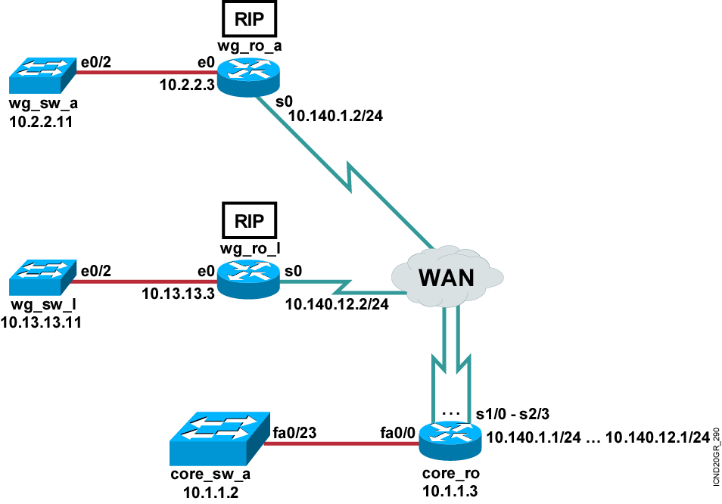
Visual Objective 5-1: Determining
IP Routes with RIP
Pod Router s0 Router e0 Switch
A 10.140.1.2 10.2.2.3 10.2.2.11
B 10.140.2.2 10.3.3.3 10.3.3.11
C 10.140.3.2 10.4.4.3 10.4.4.11
D 10.140.4.2 10.5.5.3 10.5.5.11
E 10.140.5.2 10.6.6.3 10.6.6.11
F 10.140.6.2 10.7.7.3 10.7.7.11
G 10.140.7.2 10.8.8.3 10.8.8.11
H 10.140.8.2 10.9.9.3 10.9.9.11
I 10.140.9.2 10.10.10.3 10.10.10.11
J 10.140.10.2 10.11.11.3 10.11.11.11
K 10.140.11.2 10.12.12.3 10.12.12.11
L 10.140.12.2 10.13.13.3 10.13.13.11
Notes:
Lab 9 changed existing error in addresses pod b and pod i
Objectives: Enable the RIP dynamic routing protocol so your router can learn about non-connected networks.
Purpose: Teach students how to enable RIP.
Laboratory Instructions: Refer to the lab setup guide.

Slide 15

Visual Objective 5-2: Determining
IP Routes with IGRP
Pod Router s0 Router e0 Switch
A 10.140.1.2 10.2.2.3 10.2.2.11
B 10.140.2.2 10.3.3.3 10.3.3.11
C 10.140.3.2 10.4.4.3 10.4.4.11
D 10.140.4.2 10.5.5.3 10.5.5.11
E 10.140.5.2 10.6.6.3 10.6.6.11
F 10.140.6.2 10.7.7.3 10.7.7.11
G 10.140.7.2 10.8.8.3 10.8.8.11
H 10.140.8.2 10.9.9.3 10.9.9.11
I 10.140.9.2 10.10.10.3 10.10.10.11
J 10.140.10.2 10.11.11.3 10.11.11.11
K 10.140.11.2 10.12.12.3 10.12.12.11
L 10.140.12.2 10.13.13.3 10.13.13.11
Notes:
Lab 10 amended pod b and pod I addresses move core_ro address closer to interface same with s0 pod L
Objectives: Enable the IGRP dynamic routing protocol so your router can learn about nonconnected networks.
Purpose: Teach students how to enable IGRP.
Laboratory Instructions: Refer to the lab setup guide.

Slide 16
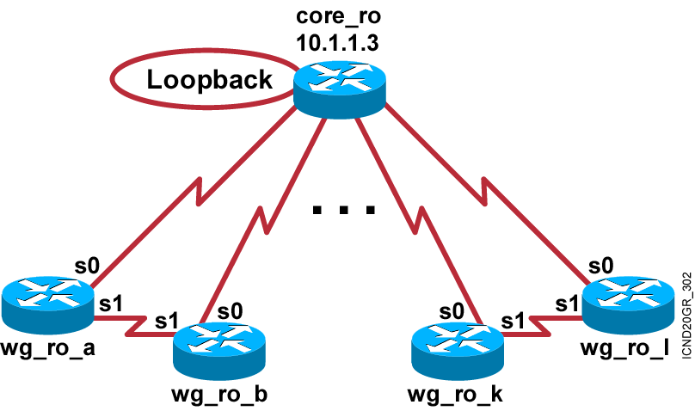
Visual Objective 5-3: Determining
IP Routes with EIGRP
Notes:
Lab 10 amended pod b and pod I addresses move core_ro address closer to interface same with s0 pod L
Objectives: Enable the IGRP dynamic routing protocol so your router can learn about nonconnected networks.
Purpose: Teach students how to enable IGRP.
Laboratory Instructions: Refer to the lab setup guide.

Slide 17
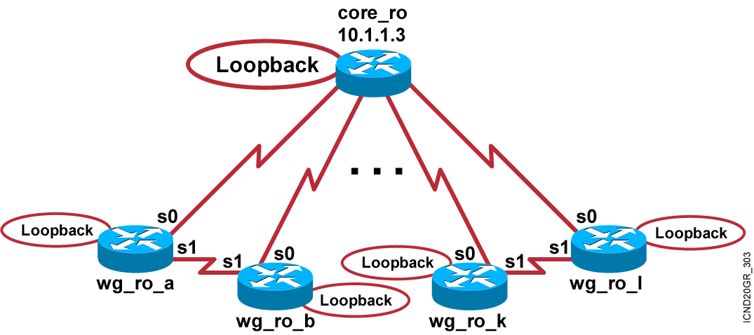
Visual Objective 5-4: Determining
IP Routes with OSPF
Notes:
Lab 10 amended pod b and pod I addresses move core_ro address closer to interface same with s0 pod L
Objectives: Enable the IGRP dynamic routing protocol so your router can learn about nonconnected networks.
Purpose: Teach students how to enable IGRP.
Laboratory Instructions: Refer to the lab setup guide.

Slide 18


